Slide 1

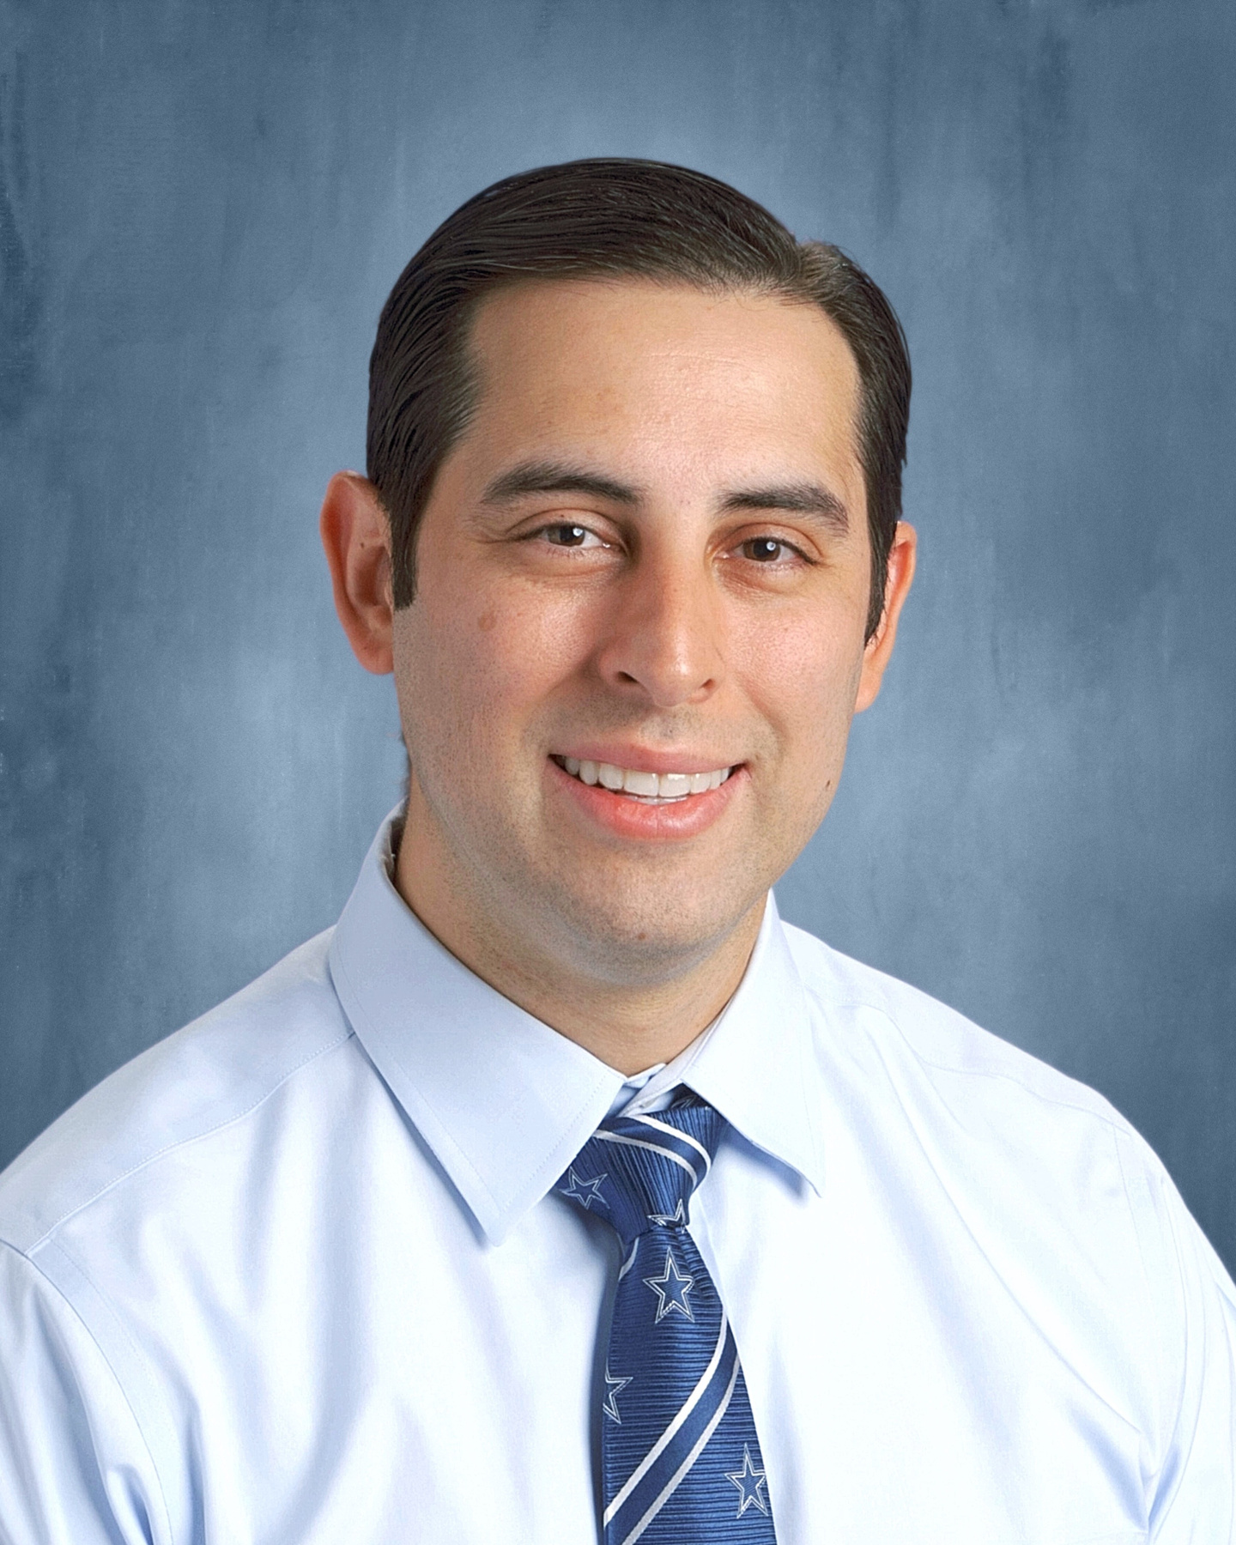
2026
Matthew 25:36c
... I was in prison and you came to visit me.
Proclaiming the Gospel of Jesus Christ to the incarcerated at Bexar County Adult Detention Center
Chaplain Bruce Gonzales

Slide 2

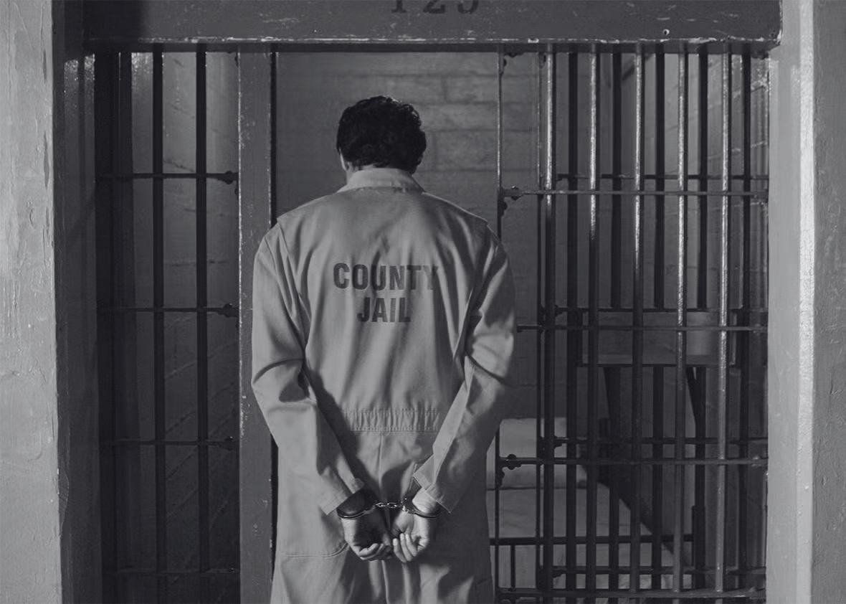

Telling T.I.M.E.
Jail: Bexar County
01
T.I.M.E.’s past: Legacy
02
T.I.M.E.’s present: already & not yet
03
Ministry: Testimonials
04
Psalm 69:33
For Yahweh hears the needy
and does not despise His,
who are prisoners.
Partnership
05

Slide 3

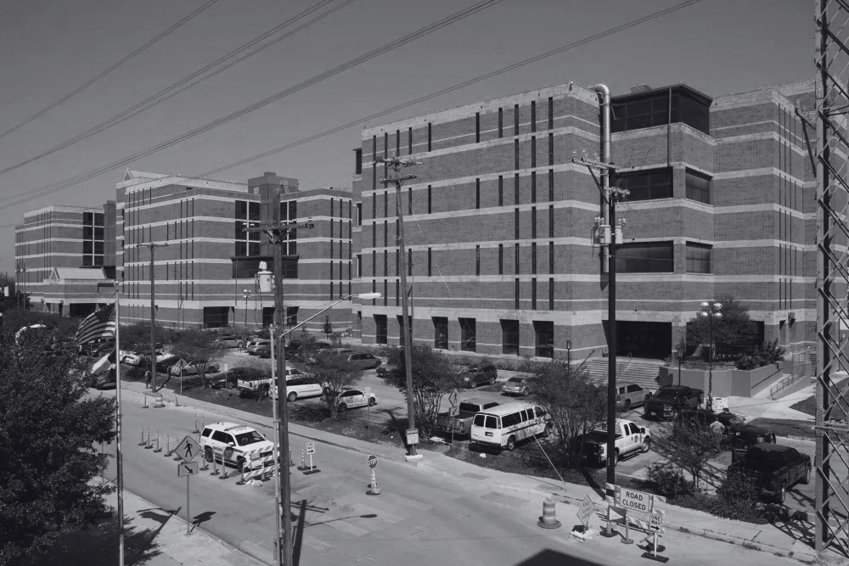
01
Bexar County Jail
The Mission Field
Bexar County Adult Detention Center /
Bexar County Jail
  3rd Largest Jail in Texas
  12th Largest Jail in the USA
  4,735 Inmates ⟶ 5,000 Max
  83% Male | 17% Female
  Ages range 16-82
  Largest group 35-44, mean: 38
  Largest ethnicity Hispanic
  Many spanish speakers
  Lots of bad press
  High need subculture within our community

Slide 4
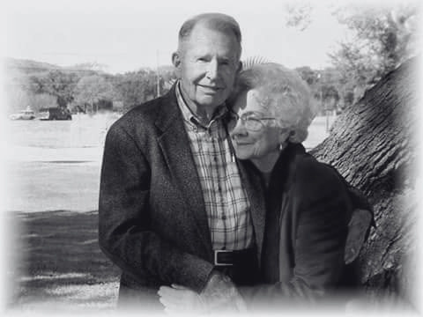
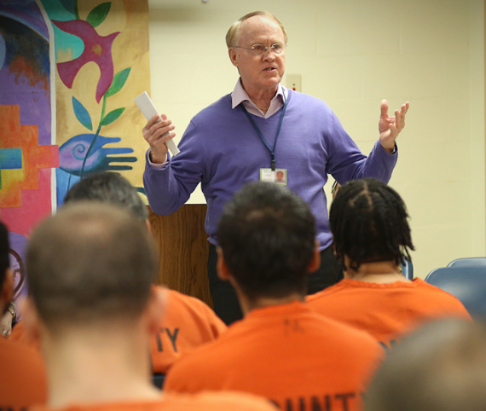
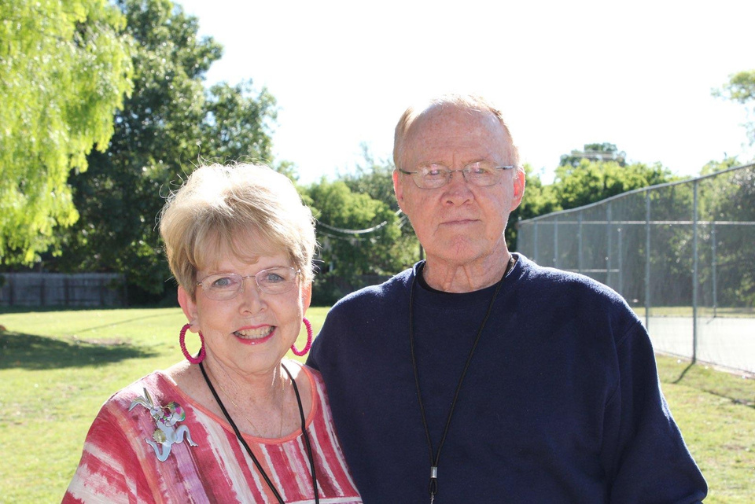
A Legacy of Faithfulness
02
  T.I.M.E. for Christ Inc began in 1960
  501(c)(3) Non-profit corporation
  Medical Missions to Mexico
  T.I.M.E. for Christ Jail Ministry began in 1970
  Nearly 50 years of faithfulness
    The McGregors, The Pucketts
    The Whites
Clem & Elsie McGregor
Ted & Sharon White

Slide 5
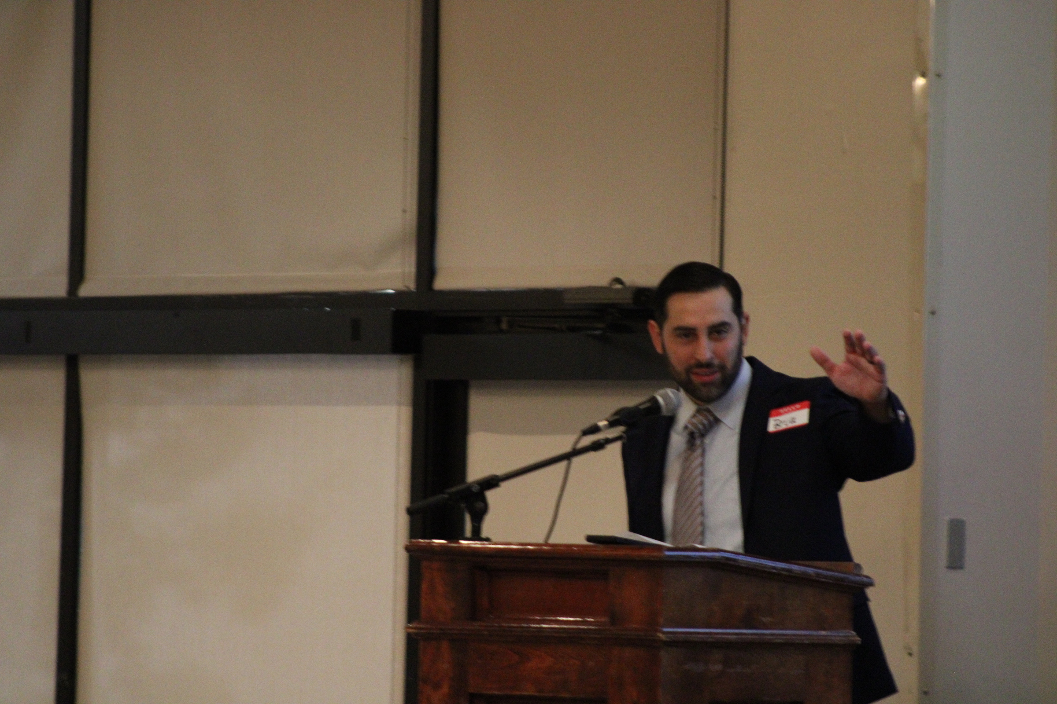
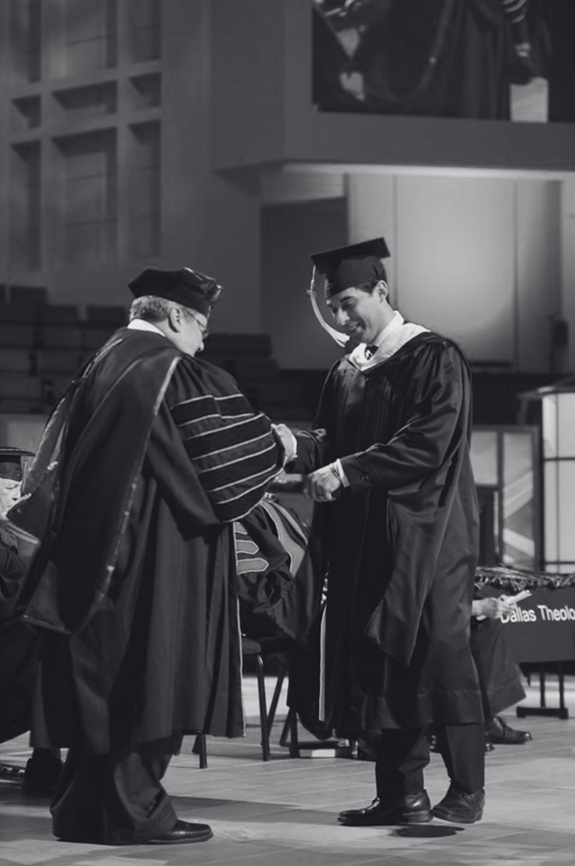
T I M E
Teaching Intercession Ministry Evangelism
03
Bruce Gonzales Jr.
Ted White
Background
  Graduated from Dallas Theological Seminary with a Masters in Biblical Studies in 2015
  Directed a non-profit Ministry since 2020
  Volunteered at the jail teaching and ministering to inmates since 2016
Duties
  Organizing and leading ~25 volunteers
  Overseeing the teaching of ~20 weekly classes
  Directing visits to minister to inmates
  Providing resources to promote discipleship
  Personally discipling brand new converts
  Troubleshooting issues
  Other various chaplain duties

Slide 6

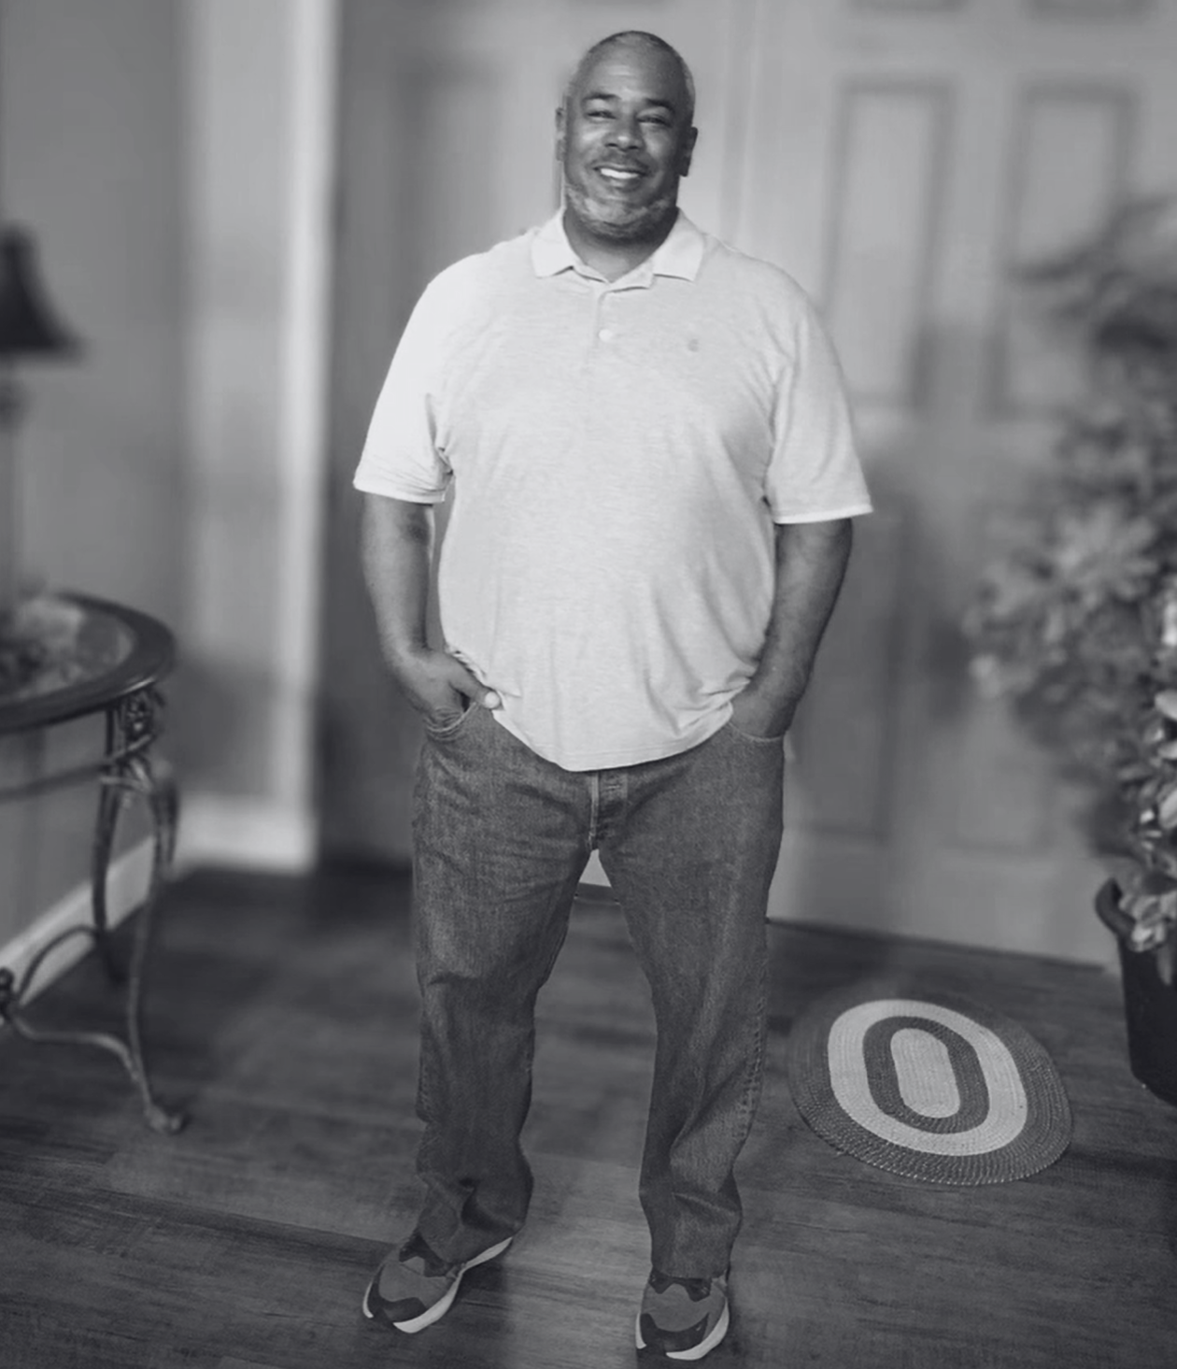


04
Ministry Fruit
Charles Williams
Discipled through Jail Classes
Pathway to Freedom Re-Entry
https://www.pathwayreentrysa.org/
Within 2 Weeks
Routine requests for Bible
Salvations
Ongoing Weekly Discipleship

Slide 7
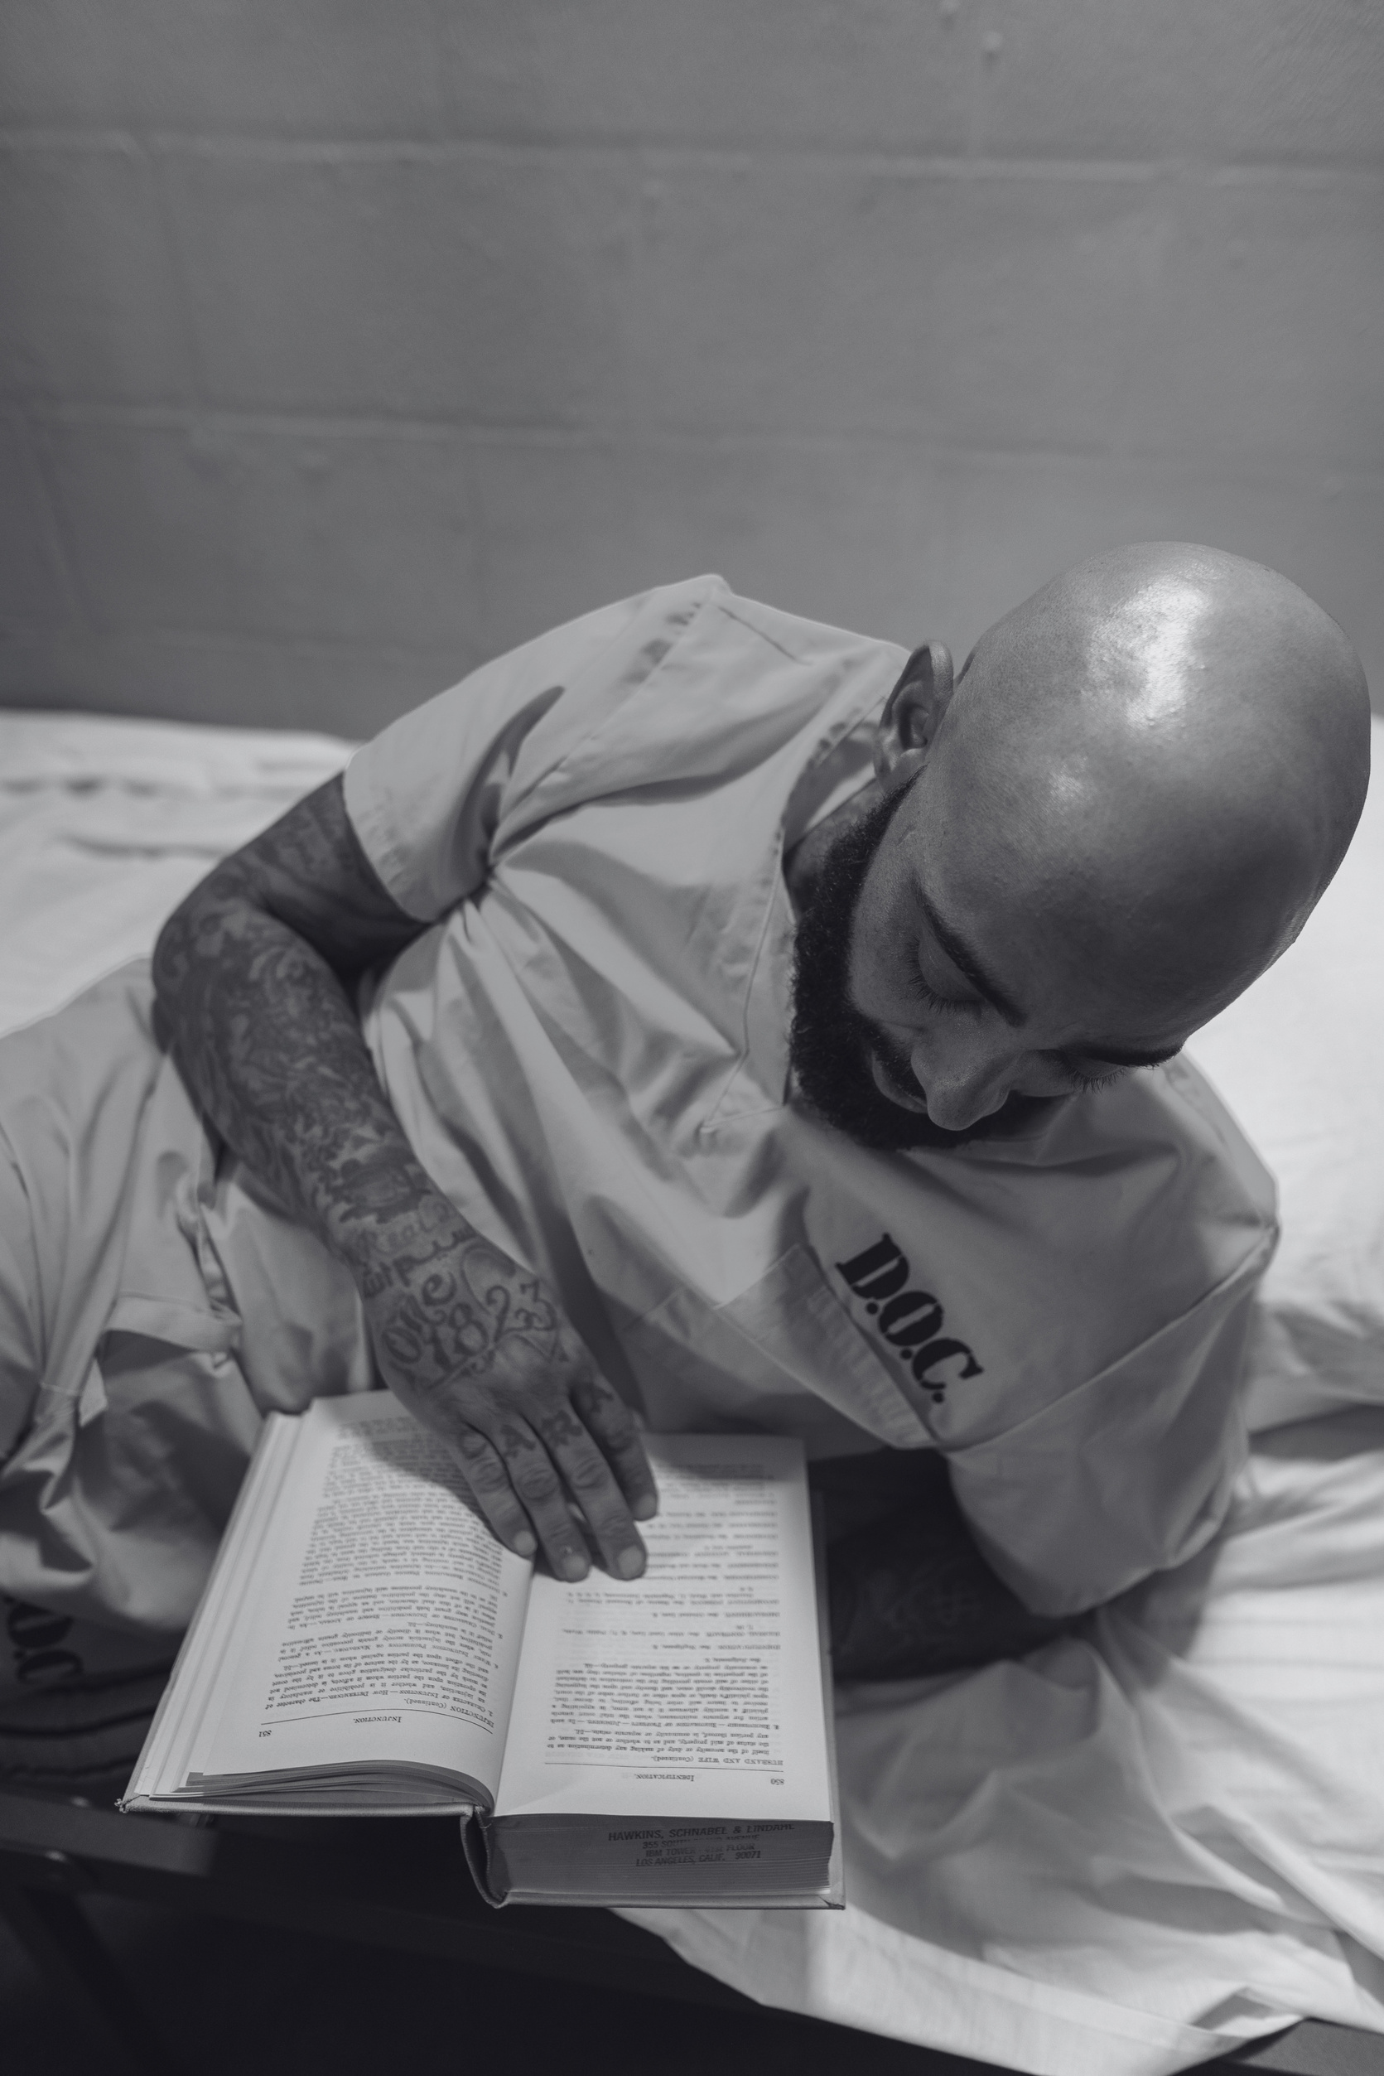
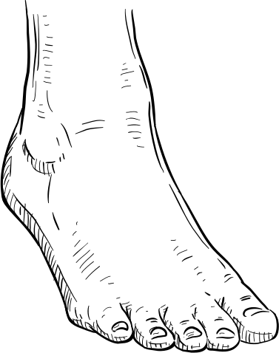
Sustaining the mission
T.I.M.E. has for nearly 50 years helped men and women incarcerated at Bexar county jail
call on the name of the Lord and be saved.
as we know “Whoever calls on the name of the Lord will be saved.” Romans 10:13 cf. Joel 2:32
the text goes on to say:
14 How then will they call on Him in whom they have not believed? How will they believe in Him whom they have not heard? And how will they hear without a preacher? 15 And how will they preach unless they are sent? Just as it is written, “How beautiful are the feet of those who proclaim good news of good things!”

Slide 8
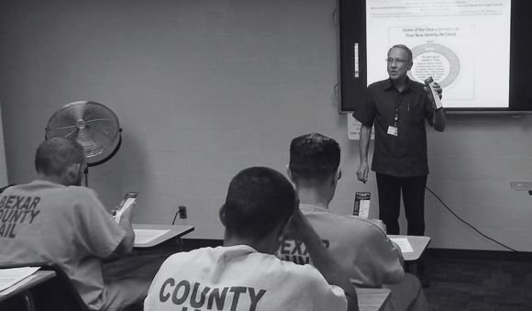
Will you prayerfully consider sending?
Join the T.I.M.E. for Christ Jail Ministry
support team

Slide 9



01
Prayer Support
Support the Mission
of T.I.M.E.
for Christ
Jail Ministry
Join our snail mail and/or email Newsletter list to get regular updates on the ministry and how you can pray.
Warriors in the unseen spiritual war.
02
Financial Support
Become a monthly financial supporter to sustain the ministry and keep our position within Bexar County providing a team of preachers to herald the good news to ~5000 inmates
03
Network Support
Help grow our support base by recommending anyone you know who should know about this opportunity to spread the Gospel in Bexar County Jail.

Slide 10
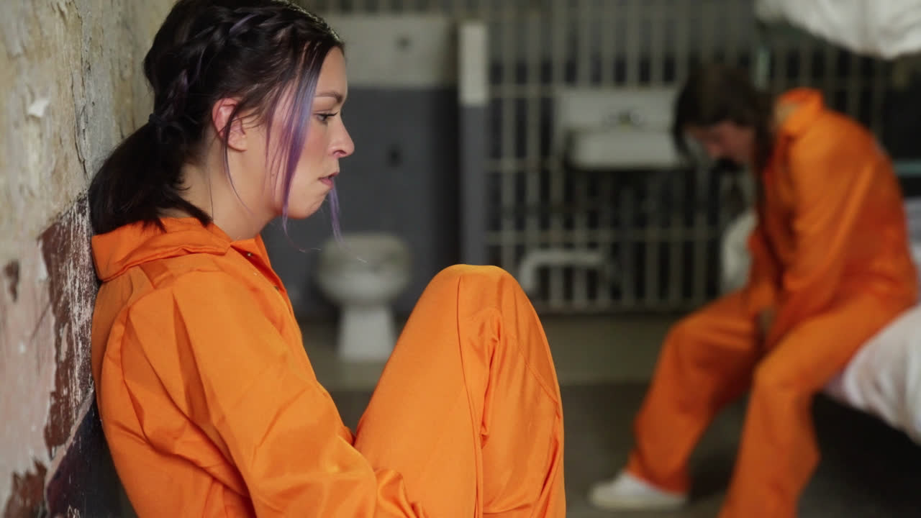
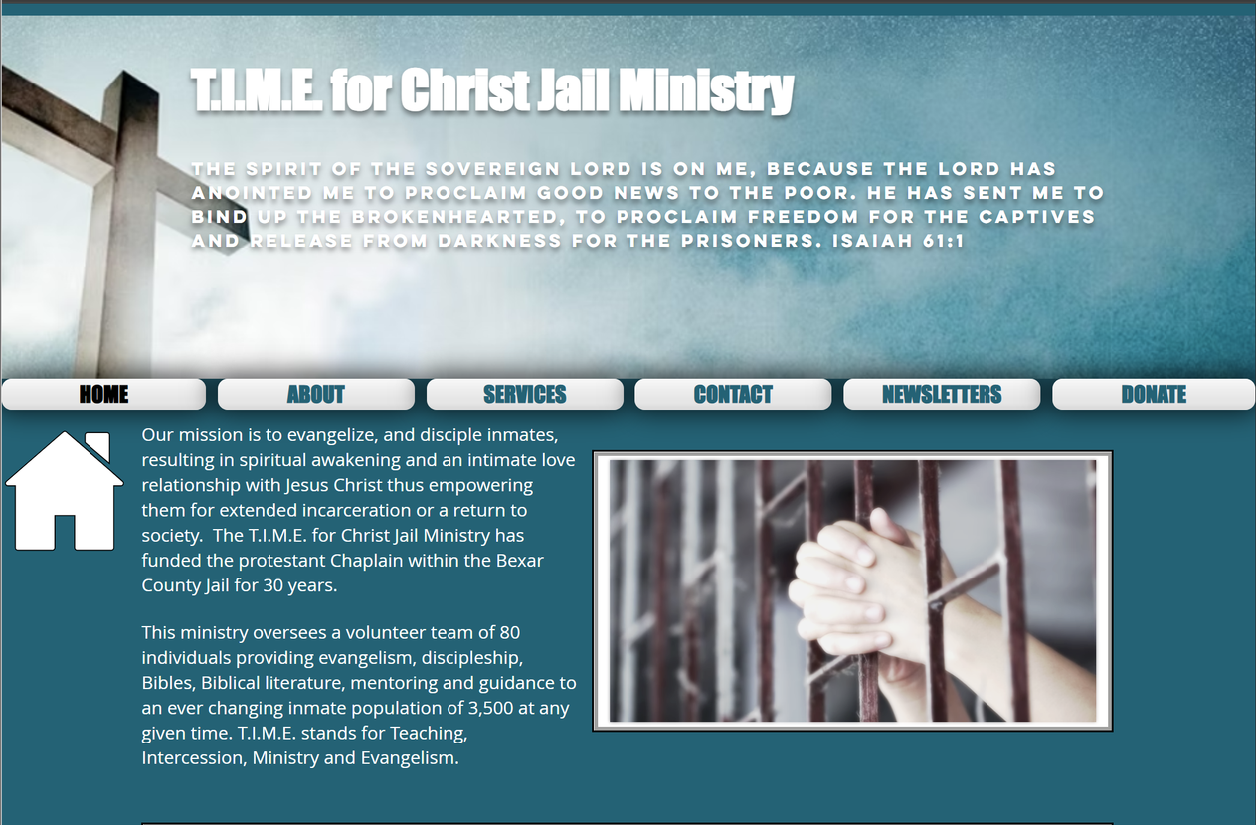
Resources
www.timeforchristjail.com
Join us to proclaim the Gospel to the incarcerated at the Bexar County Jail

